Slide 1
Module 5: Local Replication, Remote Replication, Securing the Storage Infrastructure
Dr. S. Nandagopalan

Slide 2
Syllabus
Module 5 (8 hours)
Chapter 11: Local Replication
Replication Terminology
Uses of Local Replicas
Replica Consistency
Local Replication Technologies
Tracking Changes to Source and Replica
Restore and Restart Considerations
Creating Multiple Replicas
Chapter 12 : Remote Replication
Modes of Remote Replication
Remote Replication Technologies
Chapter 14 : Securing the Storage Infrastructure
Information Security Framework
Risk Triad
Storage Security Domains
Security Implementations in Storage Networking

Slide 3
Chapter 11
Local Replication

Slide 4
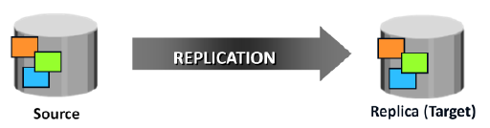
Introduction
Organizations must protect mission critical data and minimize the risk of business disruption.
If a local outage or disaster occurs, fast data restore and restart is essential to ensure business continuity (BC).
What is a Replica? It is the process to create an exact copy (replica) of data. These replica copies are used for restore and restart operations if data loss occurs.
Replication is one of the ways to ensure BC.
Types of Replication: Local and Remote
Local - replicating data within the same array or the same data center
Remote - replicating data at a remote site.

Slide 5
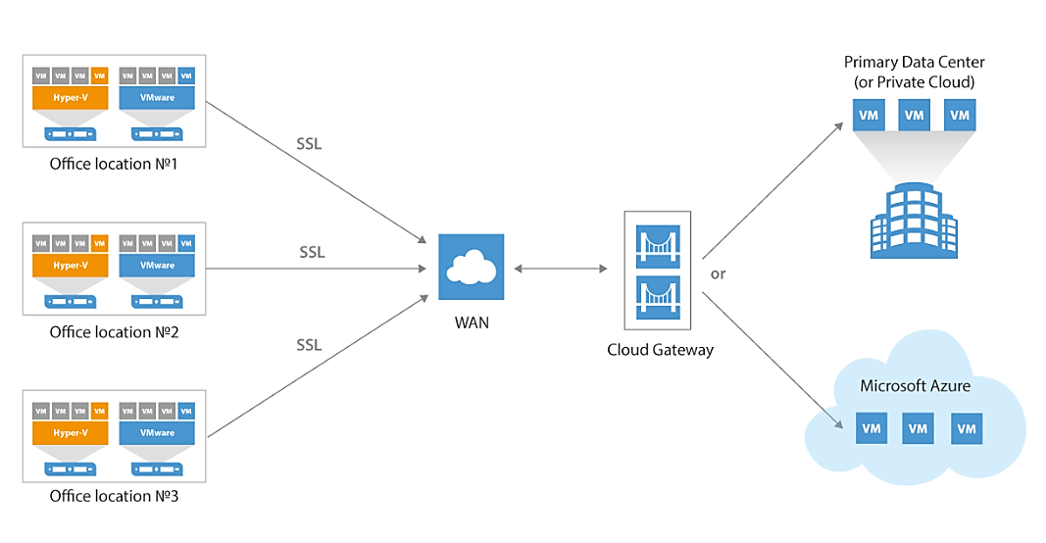
What is a Backup?
A backup is a copy of important data that is stored on an alternative location, so it can be recovered if deleted or it becomes corrupted.

Slide 6
Replica Versus Backup Copy
Parameter | Replication | Backup
Availability/Response Time | immediately accessible by applications | backup copy must be restored by backup software to make it accessible
Age of Data | Current/Live | point-in-time copy (out-dated)
Uses | used for recovery, restart, backup, reporting, and testing | used for operational or disaster recovery
Access Speed | Faster | Slower
Can Replication Replace Backup?

Slide 7
Replication Terminology
Source: A host accessing the production data from one or more LUNs on the storage array is called a production host, and these LUNs are known as source LUNs (devices/volumes), production LUNs, or simply the source.
Target: A LUN (or LUNs) on which the production data is replicated, is called the target LUN or simply the target or replica
Point-in-Time (PIT) and continuous replica: identical image of the source at some specific timestamp. The continuous replica is in-sync with the production data at all times.
Recoverability and restartability: Recoverability enables restoration of data from the replicas to the source if data loss or corruption occurs.

Slide 8
Uses of Local Replicas
Alternative source for backup – relieved copying from production LUN to backup device.
Fast recovery – provides faster recovery and minimal RTO.
Decision-support activities - running the reports using the data on the replicas greatly reduces the I/O burden placed on the production device.
Testing platform - for testing new applications or upgrades.
Data migration - migrating from a smaller capacity LUN to one of a larger capacity for newer versions of the application.

Slide 9
Replica Consistency
A consistent replica ensures that the data buffered in the host is captured on the disk when the replica is created.
The data staged in the cache and not yet committed to the disk should be flushed before taking the replica.
The storage array operating environment takes care of flushing its cache before the replication operation is initiated.
Consistency ensures the usability of a replica and is a primary requirement for all the replication technologies.

Slide 10
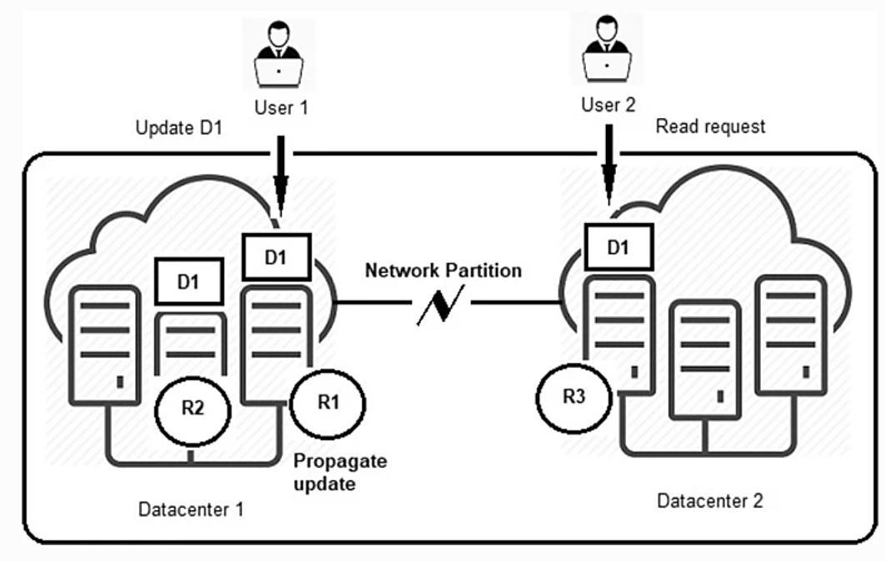
Example – CAP Theorem
User 2 performs a read request for data item D1 in replica R3 (Datacenter 2), after User 1 has updated data item D1 in replica R1 (Datacenter 1.)
Assume that update made by User 1 has not been propagated to replica R3.
Replicas may be available and User 2 will read obsolete data.
User 2 must wait until the network partition is fixed and the update has been propagated to replica R3.

Slide 11
Example – Web Browsers
To improve performance, Web browsers often locally store a copy of a previously fetched Web page (i.e., they cache a Web page).
Any subsequent request to the same page, it can be accessed from the cache – improving the performance.
What happens when the source web page has been modified?
Solution 1 - forbid the browser to keep local copies in the first place – poor access time!
Solution 2 - Web server to update each cached copy – again poor performance.

Slide 12
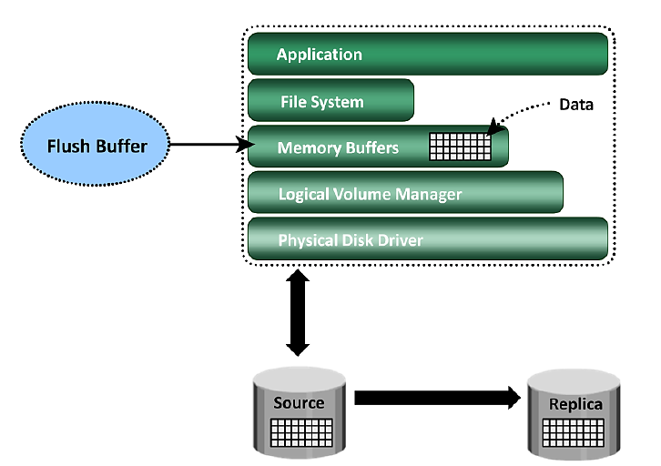
(a) Consistency of a Replicated File System
File systems buffer the data in the host memory to improve the application response time. The buffered data is periodically written to the disk.
If the host memory buffers are not flushed, the data on the replica will not contain the information that was buffered in the host.

Slide 13
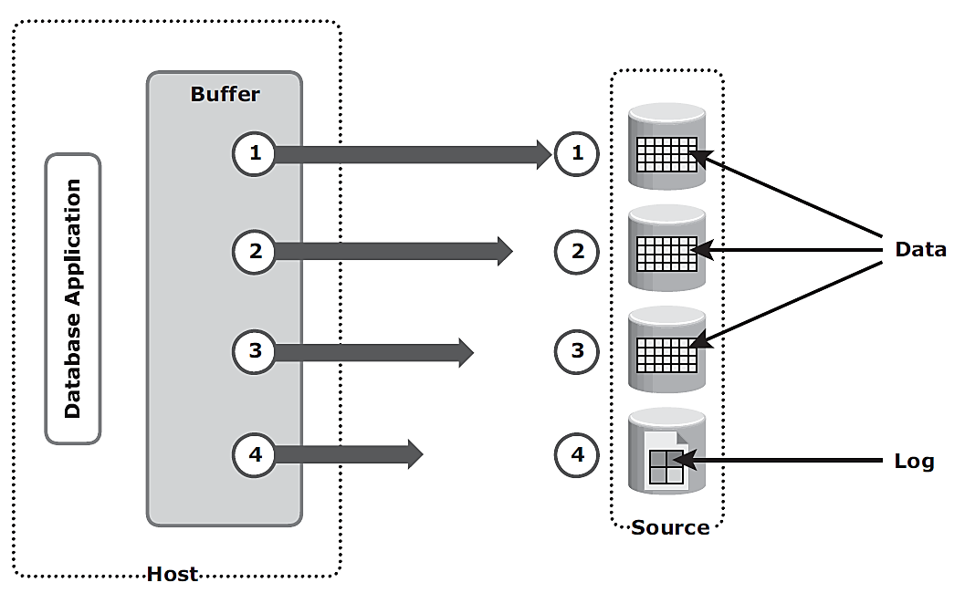
(b) Consistency of a Replicated Database
A database may be spread over numerous files, file systems, and devices – all these should be replicated for proper restore.
DBMS replication – offline / online
With offline – data is consistent as no I/O allowed
With online – replica should be continuous for consistency
Dependent write I/O - a data write is dependent on the successful completion of the prior log write.
The process of flushing the buffer from the host to the source – order to be followed.
I/O 4 is dependent on I/O 3 and occurs only if I/O 3 is complete. I/O 3 is dependent on I/O 2, which in turn depends on I/O 1.

Slide 14
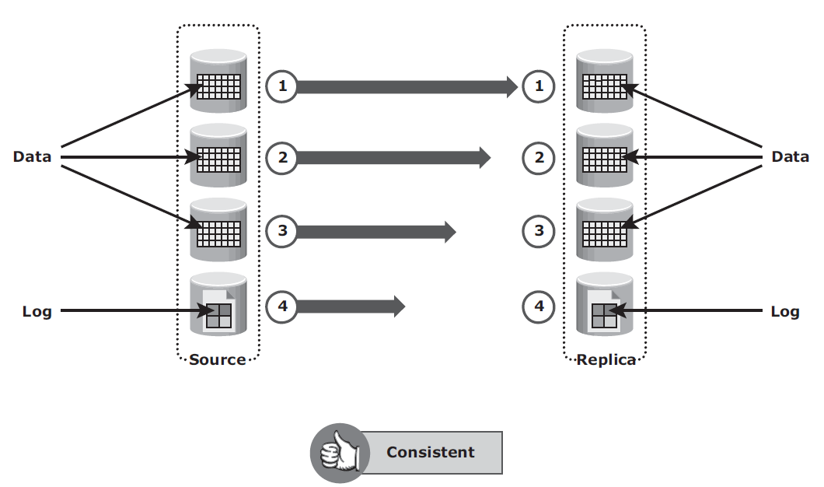
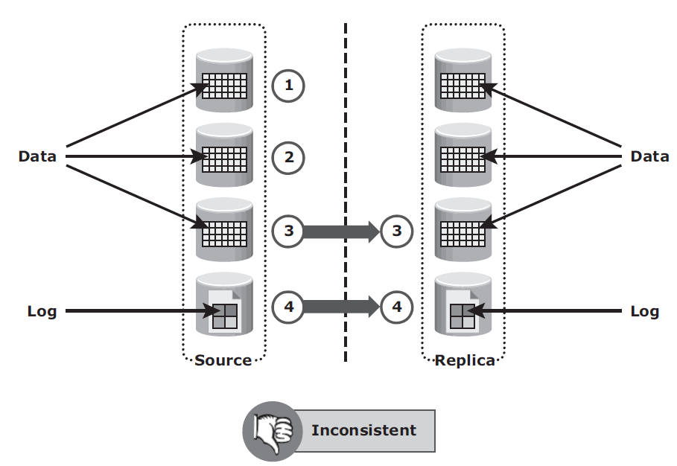
Dependent write consistency/inconsistency on replica
It is possible that I/O transactions 3 and 4 were copied to the replica devices, but I/O transactions 1 and 2 were not copied.

Slide 15
Contd.
Consistent: When the replica is created, all the writes to the source devices must be captured on the replica devices to ensure data consistency.
I/O transactions 1 to 4 must be carried out for the data to be consistent on the replica.
Inconsistent: Suppose I/O transactions 3 and 4 were copied to the replica devices, but I/O transactions 1 and 2 were not copied.
Data on the replica is inconsistent with the data on the source.
I/O4 – may indicate that the Tx is complete. But all the data is not available in the replica (1 and 2 not replicated)

Slide 16
Local Replication Technologies
Host-based replication - the practice of using servers to copy data from one site to another
LVM (Logical Volume Management) - based replication
File system (FS) snapshot – based replication
Storage array-based replication - uses built-in software to automatically replicate data
Full-volume mirroring
Pointer-based full-volume replication
Pointer based
Virtual replication
Network-based replication - uses a device or appliance that sits on the network in the path of the data to manage replication.
Continuous data protection (CDP)

Slide 17
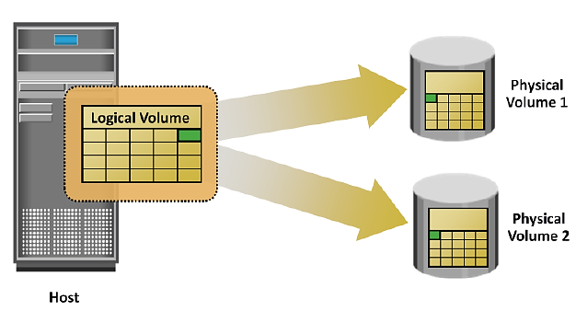
(1) Host-Based Local Replication
(a) LVM-Based Replication
Components of LVM - physical volumes (physical disk), volume groups, and logical volumes.
Each logical block in a logical volume is mapped to two physical blocks on two different physical volumes.
An application write to a logical volume is written to the two physical volumes by the LVM device driver (LVM Mirror).
Advantages
Not dependent on a vendor-specific storage system.
LVM is part of the operating system.
Limitations
Two writes on the disk increases burden on the CPU.
LVM-based local replica to another host is usually not possible.
Syncing LVM mirrors is challenging.
When server fails – nothing is available

Slide 18
(1) Host-Based Local Replication…
(b) File System Snapshot Overview
It is a virtual view of a volume or file system from a particular PIT.
After a snapshot is taken, the snapshot system preserves the view of that point in time by preserving any blocks that change after that point.
Snapshots work by creating pointers between the live data and a special snapshot volume.
These pointers are theoretically equivalent to "hard links."
As the working data diverges from the snapshot, the snapshot process uses a copy-on-first-write strategy. As a result, the snapshot only stores modified data.
After making the snapshot it is mounted on the file system and copy data from the snapshot. The resulting backup contains a full copy of all data.

Slide 19
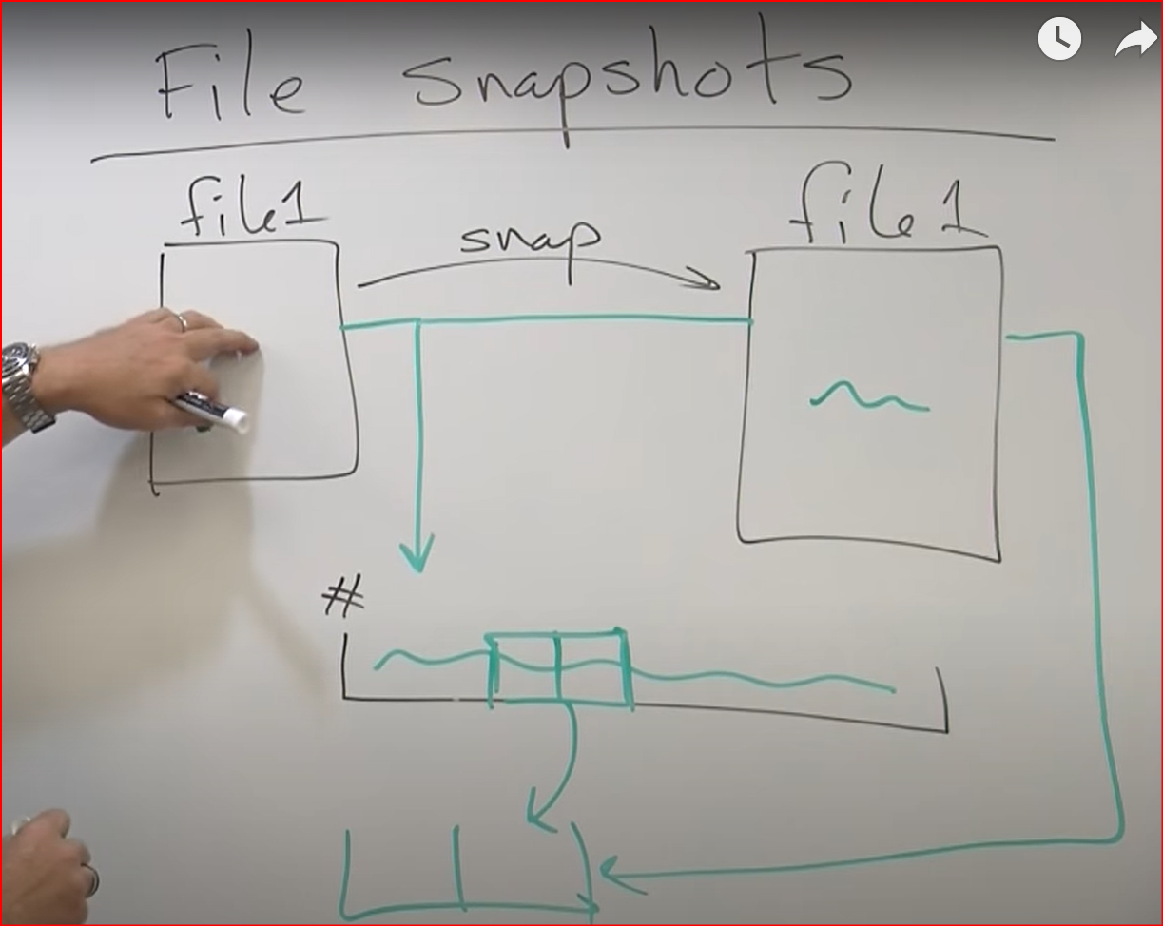

Slide 20
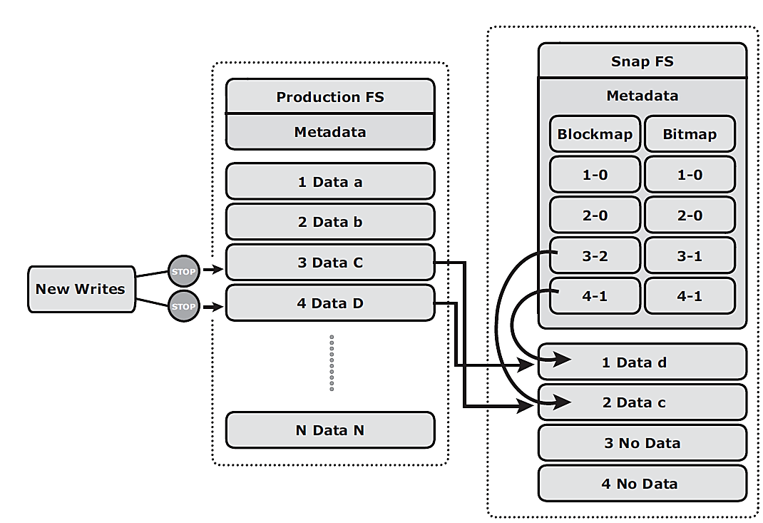
Working of File System Snapshot
When a snapshot is created, a bitmap and blockmap are created in the metadata of the Snap FS.
Bitmap - to keep track of blocks that are changed on the production FS after the snap creation.
Blockmap - to indicate the exact address from which the data is to be read when the data is accessed from the Snap FS.
If a write I/O is issued to the production FS for the first time after the creation of a snapshot, the I/O is held and the original data of production FS corresponding to that location is moved to the Snap FS.
Then, the write is allowed to the production FS.
The bitmap and blockmap are updated accordingly.
Bitmap 0 : read is directed to the production FS.
Bitmap 1 : block address is obtained from the blockmap.
“c” is changed to “C”
“d” is changed to “D”

Slide 21
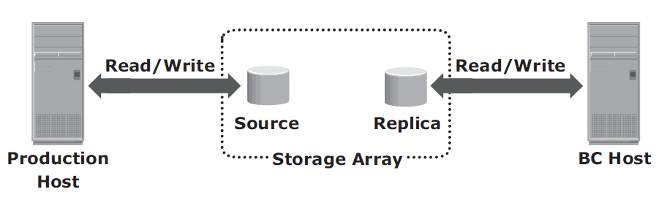
(2) Storage Array-Based Local Replication
The array-operating environment performs the local replication process.
Here, CPU and memory are not used in the replication process.
The source and target are in the same array and accessed by different hosts.
The required number of replica devices should be selected on the same array and then data should be replicated between the source-replica pairs.
Implementation:
full-volume mirroring
pointer-based full-volume
pointer-based virtual

Slide 22
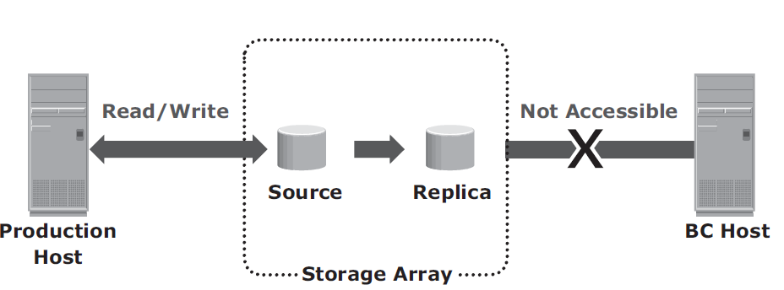
(i) Full-Volume Mirroring with source attached to Replica
The target is attached to the source and established as a mirror of the source.
Target is the mirror of the source.
Data in source is copied to target (replica) – mirror of source.
Production host continues to access the source.
Source is available only to production host.

Slide 23
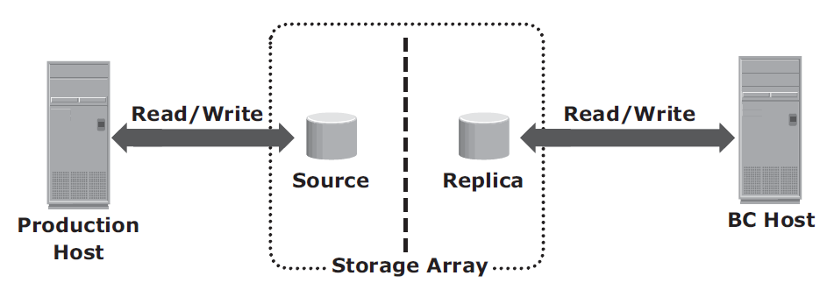
Full-Volume Mirroring with source detached from Replica
After the synchronization is complete, the target can be detached from the source and made available for other business operations.
the target becomes a point-in-time (PIT) copy of the source. The PIT of a replica is determined by the time when the target is detached from the source.

Slide 24
(ii) Pointer-Based, Full-Volume Replication
The target is immediately accessible by the BC host after the replication session is activated.
Therefore, data synchronization and detachment of the target is not required to access it.
Here, the time of replication session activation defines the PIT copy of the source.
Methods to activate:
Copy on First Access (CoFA) mode (conditions to be satisfied)
Full Copy mode.

Slide 25
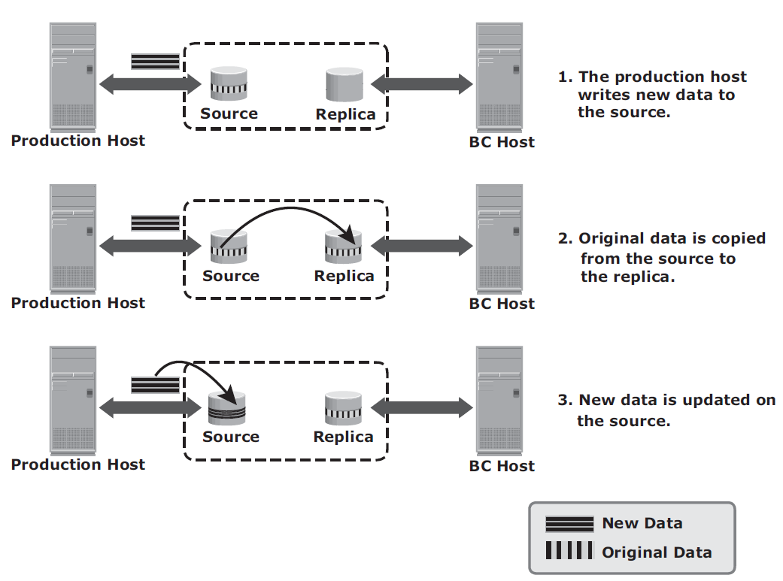
(a) CoFA - Copy on first access (write to source)

Slide 26
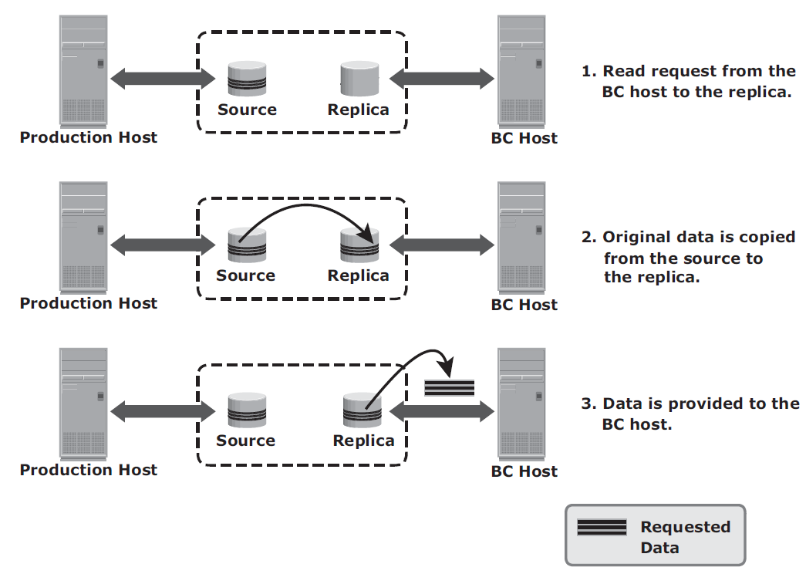
CoFA - Copy on first access (read from target)

Slide 27
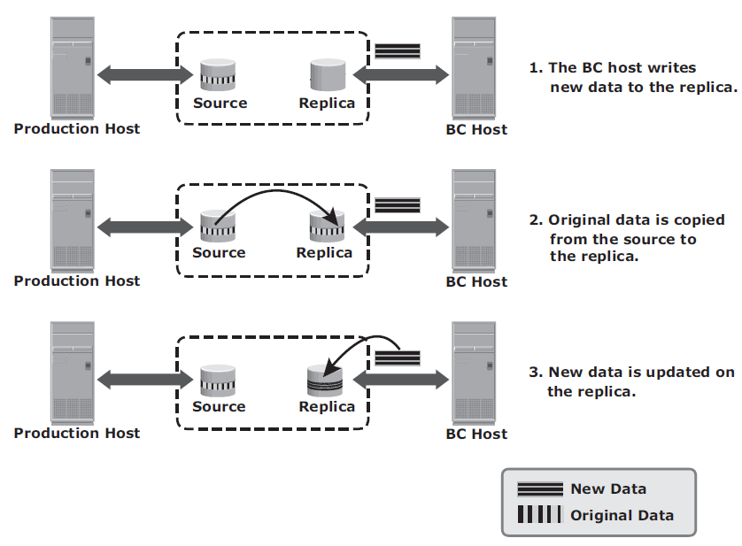
CoFA - Copy on first access (write to target)

Slide 28
(3) Network-Based Local Replication
The replication occurs at the network layer between the hosts and storage arrays.
Network-based replication combines the benefits of array-based and host-based replications.
Ideal for highly heterogeneous environments.
Continuous data protection (CDP) is used for network-based local and remote replications.

Slide 29
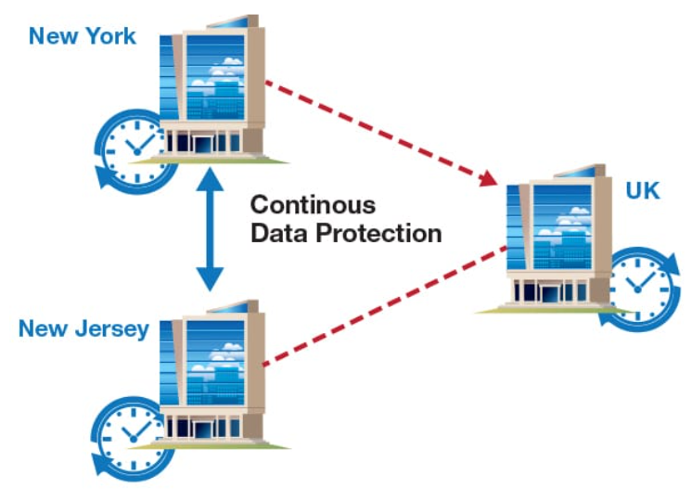
Continuous Data Protection (CDP)
CDP is a system that backs up data on a computer system every time a change is made.
Limited vs. Unlimited data recovery points.
Mirroring offers continuous replication
What happens when corruption occurs to production data – may propagate to mirror!
CDP uses a journal volume to store all data changes on the primary storage.

Slide 30
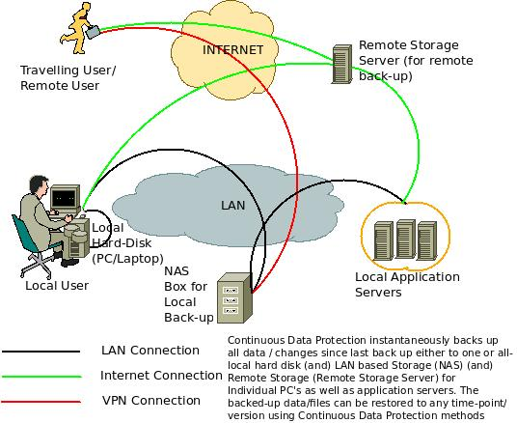
CDP…

Slide 31
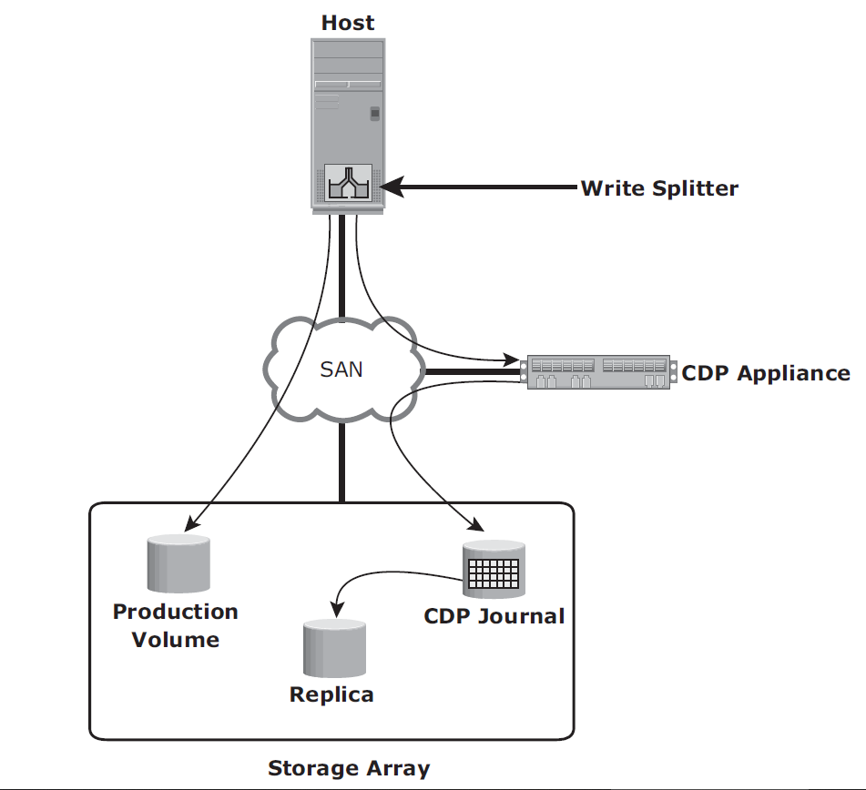
CDP Local Replication Operation
Before the start of replication, the replica is synchronized with the source and then the replication process starts.
After the replication starts, all the writes to the source are split into two copies.
One of the copies is sent to the CDP appliance and the other to the production volume.
When the CDP appliance receives a copy of a write, it is written to the journal volume along with its timestamp (for recovey).
As a next step, data from the journal volume is sent to the replica at predefined intervals.

Slide 32
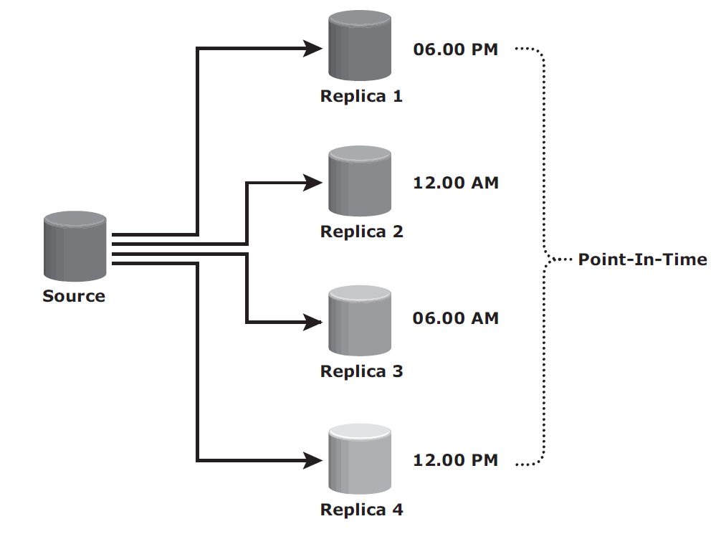
Creating Multiple Replicas
If the source is corrupted, the data can be restored from the latest PIT copy (Note: RPO = 6 hours)

Slide 33
Chapter 12 Remote Replication

Slide 34
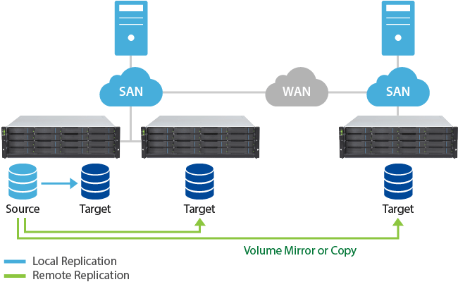
Introduction
Remote replication is the process to create replicas of information assets at remote sites (locations).
Remote replication helps organizations mitigate the risks associated with regionally driven outages resulting from natural or human-made disasters.
Remote replicas can also be used for other business operations as well.

Slide 35
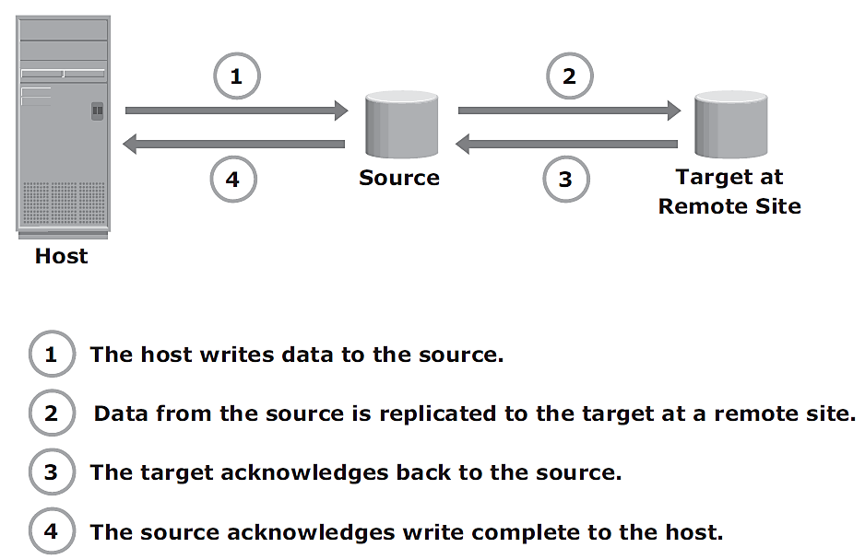
Modes of Remote Replication
Synchronous remote replication
Writes must be committed to the source and remote replica (or target), prior to acknowledging “write complete” to the host.
Additional writes on the source cannot occur until each preceding write has been completed and acknowledged.
This ensures that data is identical on the source and replica at all times.
Application response time is increased.

Slide 36
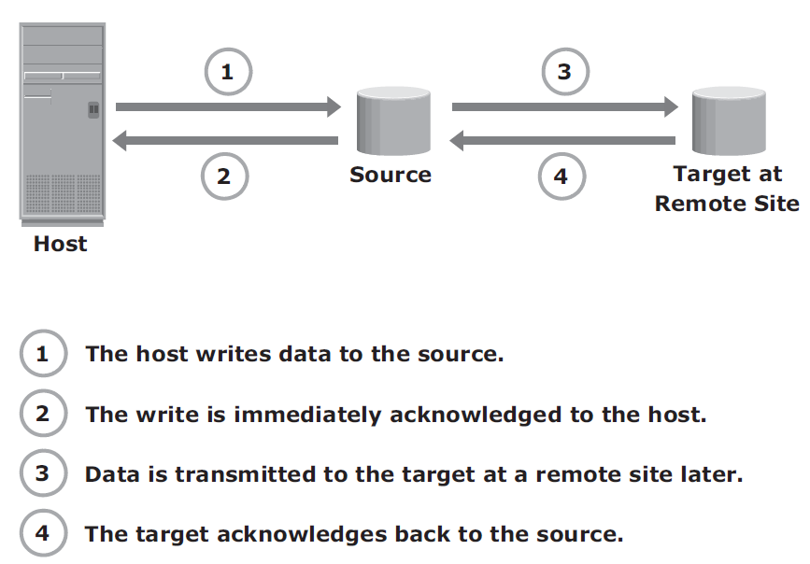
Modes of Remote Replication
Asynchronous remote replication
A write is committed to the source and immediately acknowledged to the host.
Data is buffered at the source and transmitted to the remote site later.
Writes are acknowledged immediately to the source host.

Slide 37
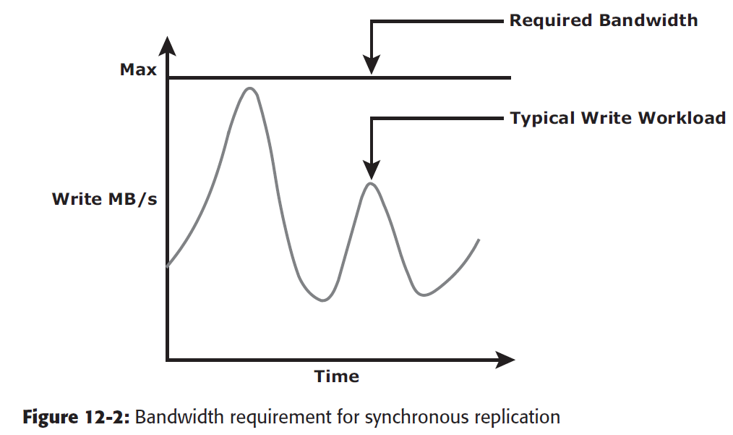
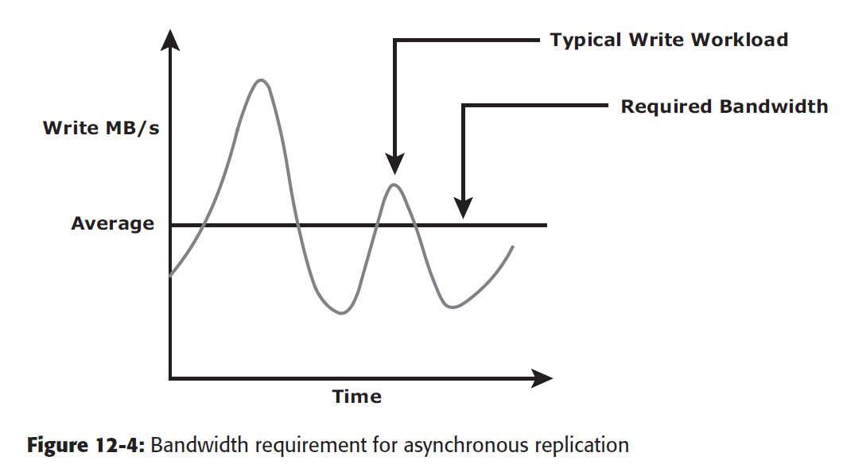
Bandwidth requirements
If the bandwidth provided for synchronous remote replication is less than the maximum write workload, there will be times during the day when the response time might be excessively elongated, causing applications to time out.
The required bandwidth can be provisioned equal to
or greater than the average write workload. Data can be buffered during times when the bandwidth is not enough and moved later to the remote site

Slide 38
Remote Replication Technologies
(a) Host-Based Remote Replication
LVM-Based Remote Replication
Host-Based Log Shipping
(b) Storage Array-Based Remote Replication
Synchronous Replication Mode
Asynchronous Replication Mode
Disk-Buffered Replication Mode
(c) Network-Based Remote Replication
CDP Remote Replication

Slide 39
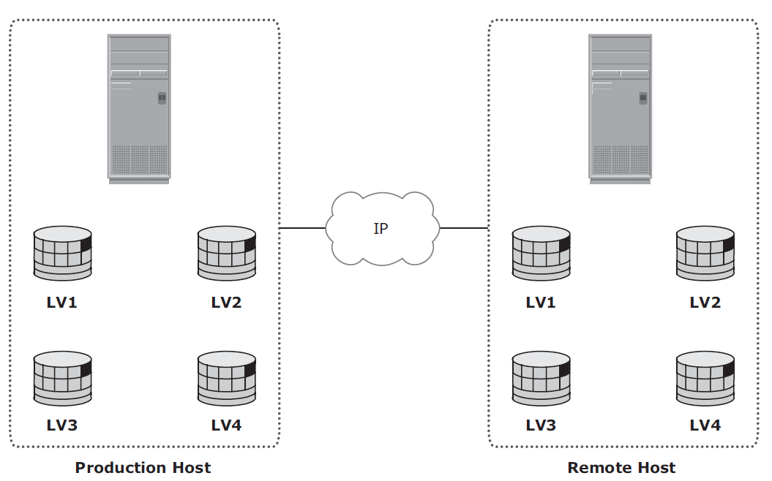
(a) Host-Based Remote Replication
Host-based remote replication uses the host resources to perform and manage the replication operation.
(i) LVM based
Volume group level
Writes to the source volumes are transmitted to the remote host by the LVM.
The LVM on the remote host receives the writes and commits them to the remote volume group.
Identical volume groups, logical volumes, and fi le systems are created at the source and target sites.

Slide 40
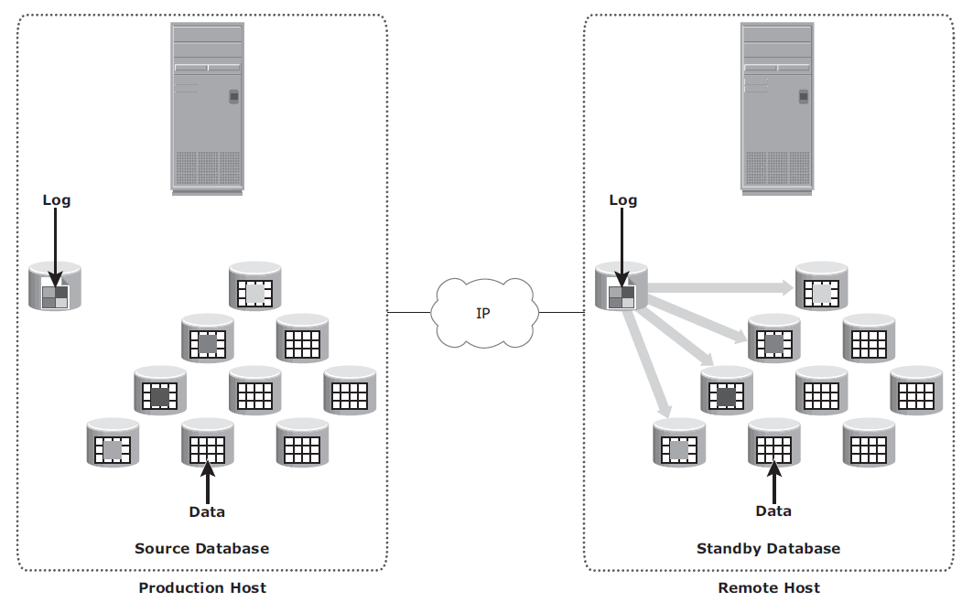
(a) Host-Based Remote Replication…
(ii) Host-Based Log Shipping
Transactions to the source database are captured in logs, which are periodically transmitted by the source host to the remote host.
All relevant components of the source database are replicated to the remote site (when DB is offline).

Slide 41
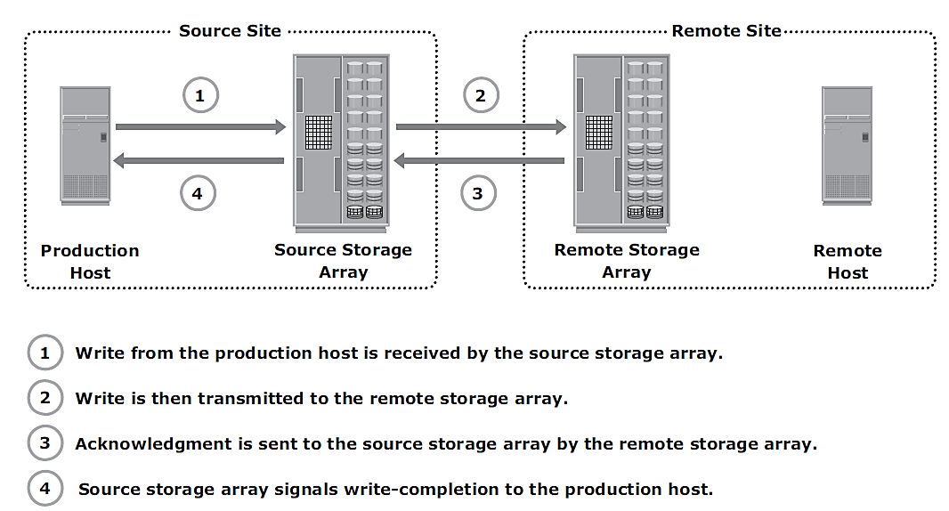
(b) Storage Array-Based Remote Replication
The array-operating environment and resources perform and manage data replication.
This relieves the burden on the host CPUs.
A source and its replica device reside on different storage arrays.
(i) Synchronous Replication Mode
Writes must be committed to the source and the target prior to acknowledging “write complete” to the production host.
Additional writes on that source cannot occur until each preceding write has been completed and acknowledged

Slide 42
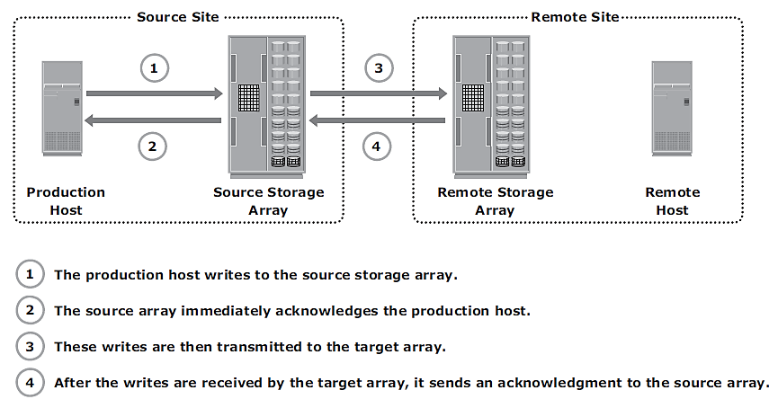
(b) Storage Array-Based Remote Replication…
(ii) Asynchronous Replication Mode
writes are placed in cache on the two arrays and are later destaged to the appropriate disks.
A write is committed to the source and immediately acknowledged to the host.
Data is buffered at the source and transmitted to the remote site later.
The source and the target devices do not contain identical data at all times.
The data on the target device is behind that of the source, so the RPO in this case is not zero.

Slide 43
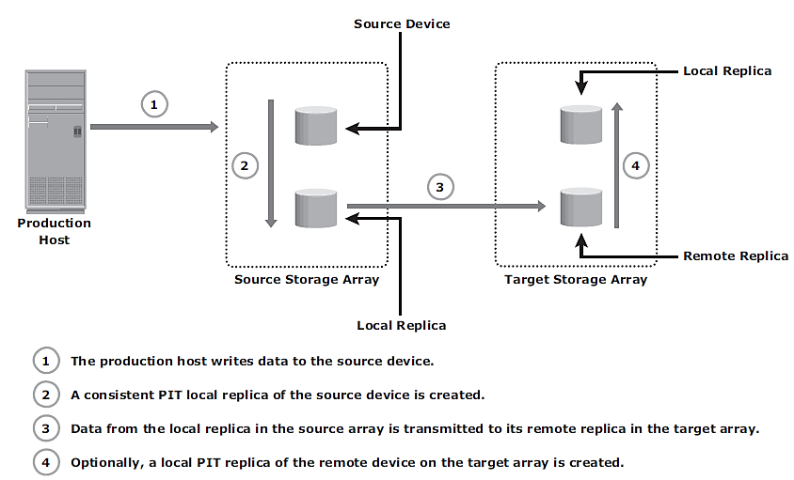
(b) Storage Array-Based Remote Replication…
(iii) Disk-Buffered Replication Mode
It is a combination of local and remote replication technologies.
A consistent PIT local replica of the source device is first created. This is then replicated to a remote replica on the target array.

Slide 44
Example
A local replica of the source device - 10:00 a.m.,
Sent to remote replica - takes 1 hour to complete.
Changes made to the source device after 10:00 a.m. are tracked.
Another local replica of the source device is created at 11:00 a.m.
During the next cycle of transmission (11:00 a.m. data), the source data has moved to 12:00 p.m.
The local replica in the remote array has the 10:00 a.m. data until the 11:00 a.m. data is successfully transmitted to the remote replica.
If there is a failure at the source site prior to the completion of transmission, then the worst-case RPO at the remote site would be 2 hours because the remote site has 10:00 a.m. data.

Slide 45
Network-Based Remote Replication
The replication occurs at the network layer between the host and storage array.
CDP (Continuous Data Protection) Remote Replication
Provides any-point-in-time recovery capability, which enables the target LUNs to be rolled back to any previous point in time.
Uses a journal volume, CDP appliance, or CDP software installed on a separate host (host-based CDP), and a write splitter to perform replication between sites. The CDP appliance is maintained at both source and remote sites.

Slide 46
Contd.
Journal Volume – It is used to store all the data that has changed on the production volume from the time the replication session started. The journal contains the metadata and data that will allow rollback to any recovery points. The amount of space that is configured for the journal determines how far back the recovery points can go.
CDP Appliance – A CDP appliance is an intelligent hardware platform that runs the CDP software and manages local and remote data replications.
Write Splitter – Write splitters intercept writes to the production volume from the server or host and split each write into two copies. Write splitting can be performed at the host , fabric, or storage system level.

Slide 47
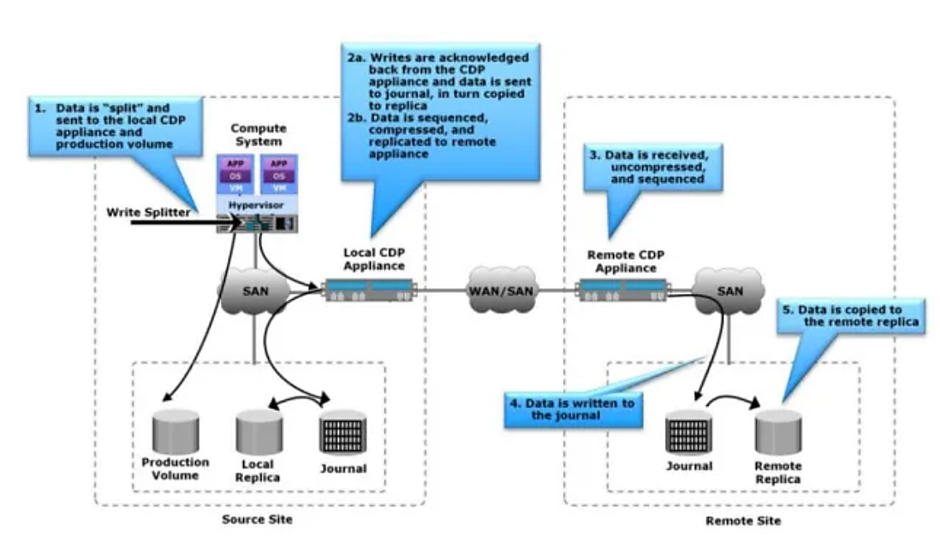
How CDP Works?

